Slide 1
CAFE COFFEE NIGHT ANALYSIS
- Project
Vompolu Sai Tanuj
G1 – PGPBABI(June 2019)

Slide 2

Introduction
Being ahead of the competition is the primary objective of any retail business. As the competition keeps rising in the retail environment, more and more businesses are looking towards Analytics to attract more customers and generate higher revenue. In the environment of Market Retail Analytics, every transaction holds an important value and the information it holds will give us significant insights.
Our project is one of such cases where the owner of Cafe Coffee Night has the data of transactions that occurred at the POS (Point of Sale) in one of the chains. We need to come up with suitable recommendations that will help the business launch royalty programs and increase his revenues.
The analysis can be done by the means of Exploratory Analysis and Market Basket Analysis to arrive at conclusions and to give recommendations.

Slide 3
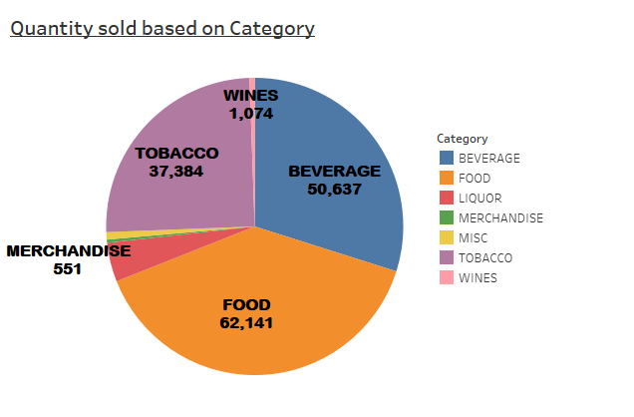
EXPLORATORY ANALYSIS
The highest quantity of items that are being sold belong to the Beverage category.
The items that get sold in lesser quantity belong to the Merchandise category
The beverage items cant be stored for long time and hence the café will put heavy emphasis on getting more number of items sold.
Many of the customers would enter the café hoping to get a hot beverage (Coffee) as the name of the Café Coffee suggests and would prefer them over merchandise which include T-Shirts, Mugs, Cards, etc.

Slide 4
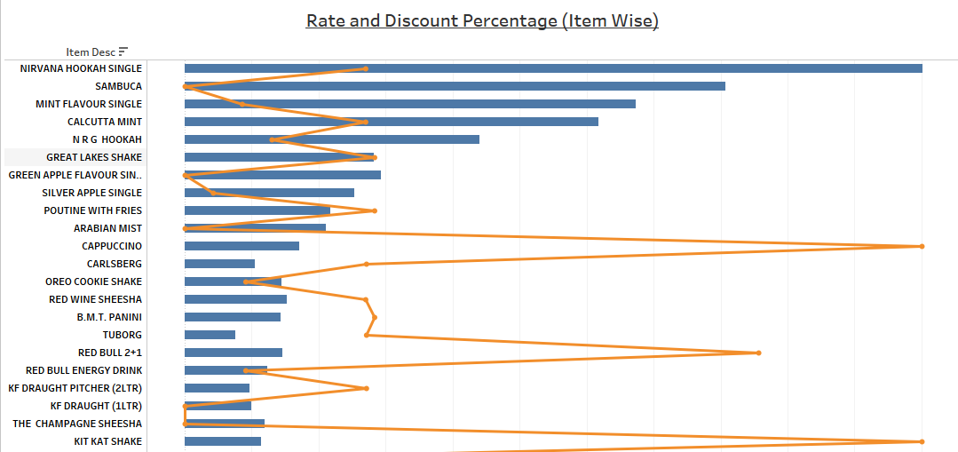

The most expensive item available in the Café is Nirvana Hookah Single.
The discount given ranges from 0% to 100%
The top 5 most expensive items belong to the Tobacco Category.
Majority of the items where a 100% discount is given belong to the Beverages category.
None of the items on the cheaper side are given discount.
The café has put discounts on items belonging to Beverages, Tobacco and Liquor due to these items being on the higher prices compared to items in other categories.

Slide 5
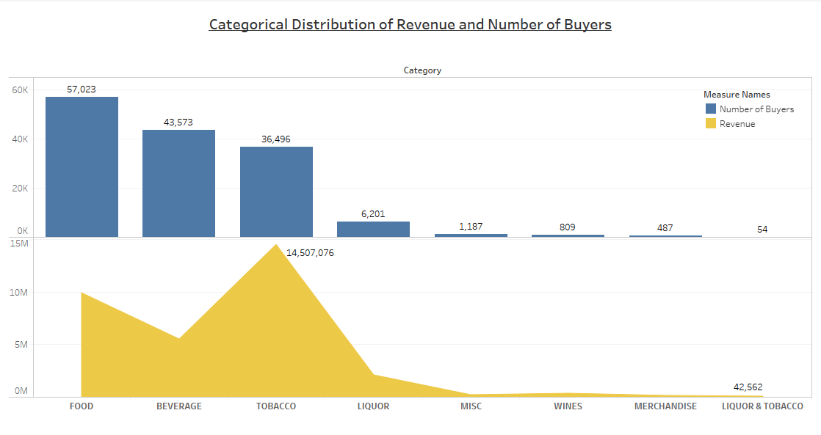
Food category has the highest number of buyers while the category Liquor and Tobacco have the least number of buyers.
The Tobacco category contributes the highest to the revenue while Liquor and Tobacco contributes the least to the revenue.
The reason for the lowest contribution to revenue and lower number of buyers is because under that category, there exists only five types of items, thus not accounting for revenue or number of buyers.

Slide 6
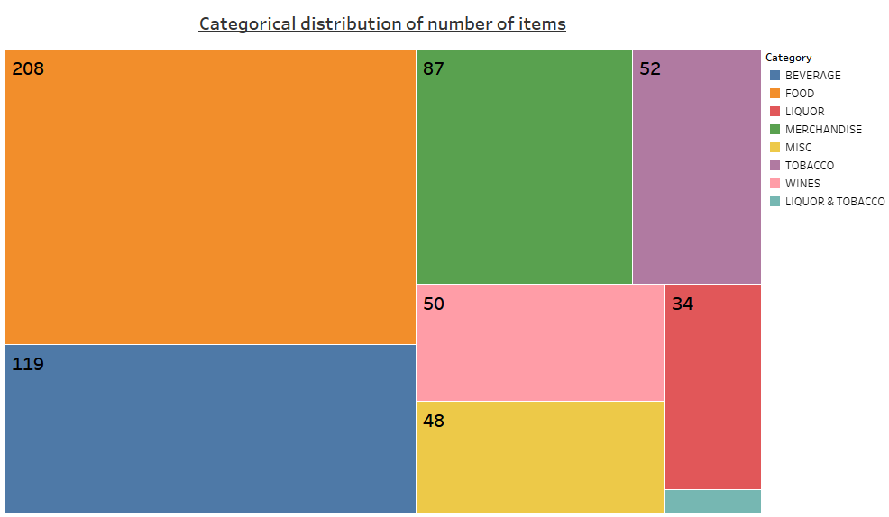
The total number of items available in the menu are 602
The highest number of items belong to the Food category
The least number of items belong to the Liquor and Tobacco category
The variety of items include branded items like Red Bull, Maggi, in-house brand items like Great Lakes Shake, Great Lakes Frappe, and also unbranded items like pink lemonade, Chai Latte.

Slide 7
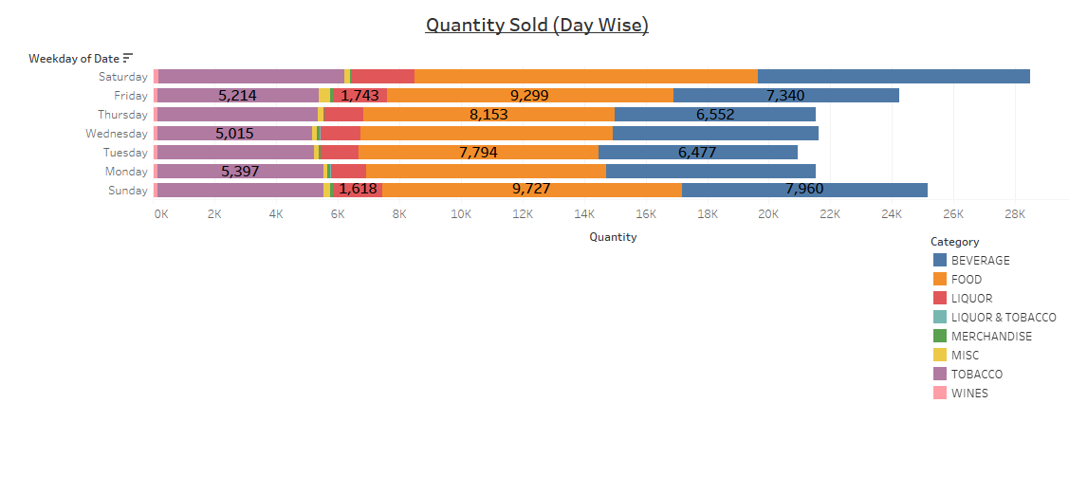
The highest quantity of items are sold on Saturday.
At any given day, majority of the quantity is contributed by the items in Food category.
The items in the Liquor and Tobacco are sold in least quantity whatever might be the day.
The least quantity of items sold compared to all the other weekdays is Tuesday.
The quantity of items in the categories Merchandise, Wines and Liquor and Tobacco can be considered insignificant as compared to the other categories.
The quantity of items sold on Saturday and Sunday are more compared to other days because those are the only days when the Café serves all day while it losses sales due to working hours on other days.

Slide 8
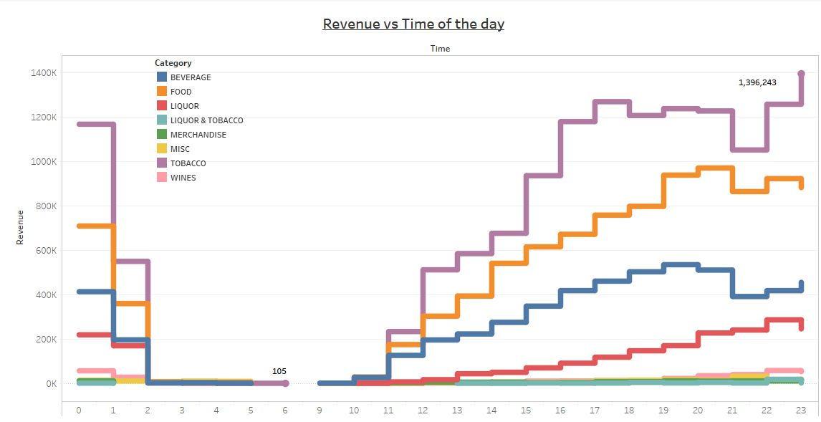
No matter what category the items lie into, every category has good revenues between 00 hours and 02 hours. Then from there, it decreases drastically until 11 hours in the and picks up again by 12 hours and reaches the peak point at 23 hours.
At any given hour in the day, the revenue generated by items in Tobacco category is the highest.
We can see that evenings and late nights are important generators because it is the time when Tobacco is preferred by employees and it is also only time when employees are devoid of work.

Slide 9
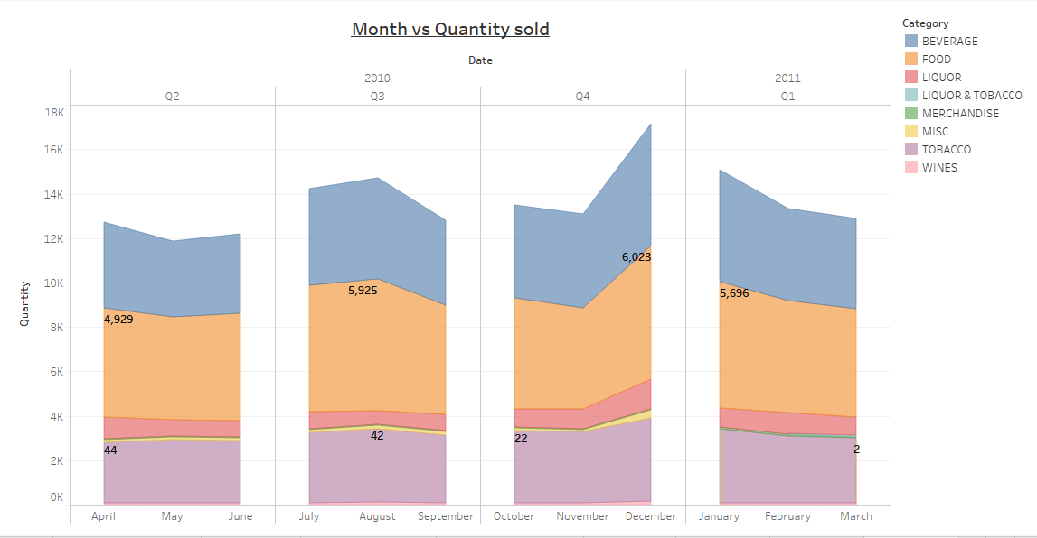
The quantity of items sold reaches the peak in the month of December.
The quantity of items sold is the least in the month of May.
All the items from all the categories follow the same trend across various months.
The second quarter(Q2) is when the least quantity of items are sold.
Highest quantity of items were sold in the fourth quarter (Q4).
We can observe that the quantity sold is higher in the months of December and January due to winter season where customers prefer something warm and Café has many such items like different wines, Tea, Roast Chicken, etc to offer. Same happens in the month of August when it is rainy season and customers are inclined to warm items which are available abundantly in the menu of the Café.

Slide 10
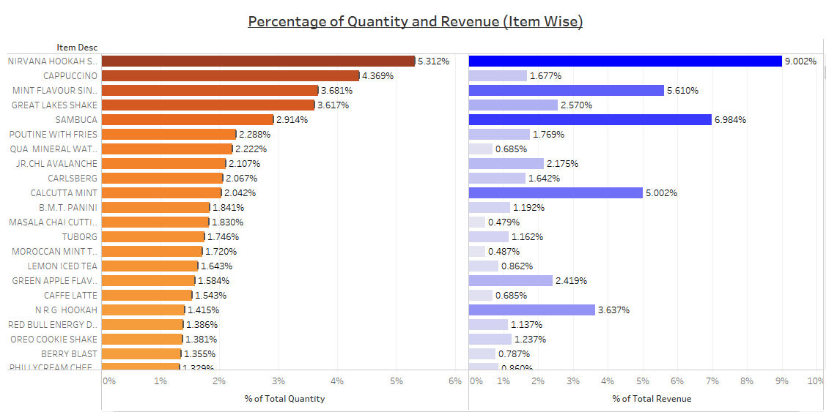
Nirvana Hookah Single is the item that contributes most in terms of Quantity and Revenue.
We can use the above graph to determine which items could be taken off the menu due to their insignificant contribution to both the total quantity and total revenue.

Slide 11
Items that can be taken of the menu
Items that can be taken off the menu can be decided based on a particular threshold we put on the quantity and revenue got from that specific item.
In our case, we can put the threshold at 0.06% of the total for quantity and 0.66% of the total revenue it is responsible for.
Based on this, a list (excel file) has been attached to the image containing the items that have to be removed and can be accessed by double-clicking on the above image.

Slide 12
MARKET BASKET ANALYSIS
Understanding the customer behaviour is very important step in the study of Marketing. Making every customer feel like the business knows them leads to increase in revenue from them. This understanding helps the businesses stay ahead in the competitive field of retail market.
One such technique used is known as Market Basket Analysis. It is a set of statistical affinity calculations based on the principle of Association Rules. According to this theory, it suggests that if a customer who buys a certain item (or items) is more probably going to buy another specific item (or items).
This concept can be widely used to detect the customer buying patterns and change their Retail marketing strategies such that it can attract more and more customers.
The businesses can then properly adhere to the specific customer needs by placing discounts, placing the items next to each other, advertising the consequent product, etc.

Slide 13
Market Basket Analysis uses the algorithm of apriori which states that any subset of frequent item set must be frequent. The technique has two main components, the item set and the consequent set. The technique of Market Basket Analysis has three important parameters that need to be tuned according to the needs of the marketing team. These parameters help in selecting only those combinations which carry proper weightage. The three parameters are as follows:
Support: It helps us give an idea on the popularity of the item set. It gives the frequency of the item set against the total number of transactions.
Confidence: It helps in comparison of frequency of transactions containing both item-set and consequent with the number of transactions containing consequent.
Lift: It is a factor by which the probability of buying both item set and consequent together is multiplied by probability of buying only the item set only.
The value for lift must be above 1 to ensure that combinations chosen are frequent combinations and favoured by the customer base of that business. Higher the values of Support, Confidence and Lift, better combos can be chosen.

Slide 14
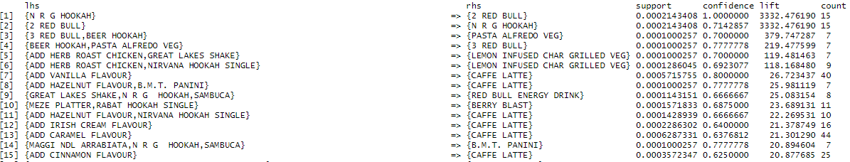
Top combos that can be added to the menu
In the above results the items on the Left Hand Side are the item sets while the items in the Right Hand Side are the consequents.

Slide 15
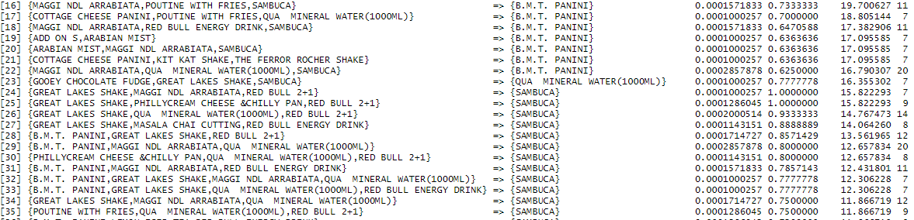

Slide 16
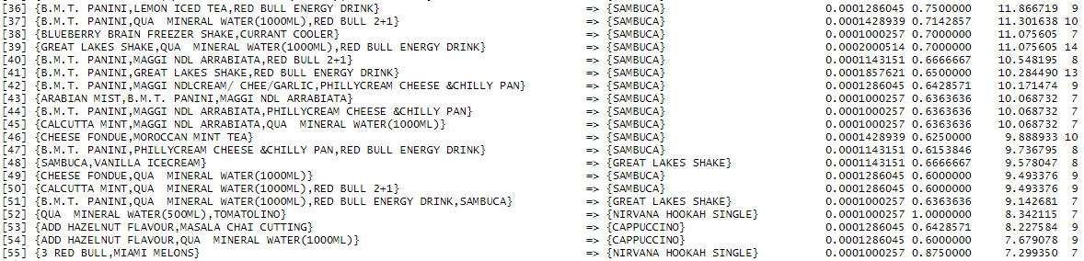

Slide 17
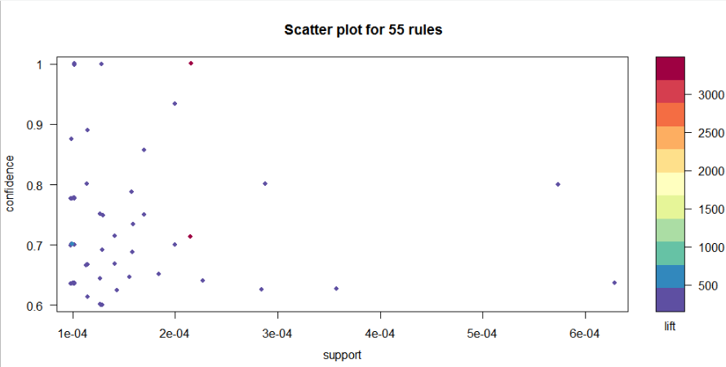
The scatter plot below shows the distribution of the 55 rules with respect to the three parameters of Market Basket Analysis, Confidence, Support and Lift.

Slide 18
The above combinations can be added to the menu based on the requirement of the management and marketing team and the same can be advertised accordingly.
After analysis of the above combinations, the following can be observed,
Café Latte is preferred more with additional ingredients such as Hazelnut, Vanilla, cinnamon, etc. and is very rarely taken alone.
Great Lakes Shake appears in most of the combinations but is seen in the LHS side only.
Sambuca is the most occurring item in all the combinations and is seen on the RHS side.
Most of the items that appear on the LHS belong to the Food category.
Even though most of the combos have a support as low as 0.0001, meaning that the items in the item-set alone doesn’t appear in many of the transactions, but they appear in the combos along with many other consequents which is indicated by the confidence values of the combinations being above 0.60.

Slide 19
Conclusion
As a Business Analyst, we have been tasked by the owner of coffee chain to perform a proper analysis on the sales that are occurring at one of the branches of his coffee chain and suggest some combos for the menu which can be added to attract more customers and increase revenue.
The data given to us consisted of monetary transactions that have happened at the Point of Sales. The project was approached in two ways, exploratory analysis and Market Basket Analysis.
Performing exploratory analysis gave us insights on consumer behaviour over different times of day, various days and various months. The trends of revenue and quantity sold were analysed using separate graphs. By placing a threshold on revenue and quantity sold, list of items were created which could be removed from the menu due to their insignificant contribution to the Revenue.
Market Basket Analysis technique was applied to the data and 55 combos from the items in the menu were created using the three parameters of the Market Basket Analysis and the inferences were given for the same.

Slide 20
Based on the analysis done in the project, the following suggestions can be provided to the owner of the Café Chain.
Since the name of the Café Chain restricts the minds of the customers to expect only food items, beverages, etc., the name of the Café chain can be changed or else an indication must be shown that Café offers wide variety of categories such as Merchandise, Wines, etc.
Instead of placing discounts on the higher priced items, Café can make offers where buying of a priced item would yield them a discount on the items with lower price and lesser sold. In this way, the revenue lost on putting discounts on higher items is downsized and also increase the sale of discounted items.
Café can add some breakfast items in the menu like sandwiches, scrambled eggs, waffles, etc. to increase the flow of customers in the daytime and get more revenue.
Café can put up a special day on every Tuesday when the sales are lower compared to the other days where they put discounts on most popular items in order to attract customers.
Café can put seasonal offers increase revenues to increase revenue of the categories which are lesser in different seasons.
Café can use the combos to increase the sales of the consequent item either by placing discounts or suggesting the consequent item when the Item-set is chosen.
The Café must place separate sections for Teetotaller and Non-Teetotaller so that sales of one section of the customers will not affect the other section.

